Slide 1

FuelFinder
Presented by:Team 9000
Rafid Rahman, Nizar Azar, Shahed Ahmed, Muhammad Ahmed, Kalelo Dukuray, and Mustafa Donmez
April 2, 2025

Slide 2






Meet The Team
Nizar Azar
Kalelo Dukuray
Mustafa Donmez
Shahed Ahmed
Rafid Rahman
Muhammad Ahmed

Slide 3



What, Who, How and Why
WHAT IS THE IDEA?
WHO NEEDS IT?
WHY WILL an investor WANT TO Invest in YOUR APPs?
A web app that helps users find the cheapest and closest gas stations using real-time, crowdsourced data. We aim to offer a clean, mobile-friendly interface with features like filters and station reviews.
Everyday drivers, commuters, rideshare drivers, and fleet managers—anyone looking to save money on gas and find the most convenient station fast.
Gas prices are always changing, and users need ways to save. Our app tracks traffic data, has good demand, revenue from ads and partnerships, and potential to grow into EV, parking, and car services.

Slide 4
Use Cases
Find the Cheapest Nearby Gas Station
User: Sarah, a college student on a tight budget
Sarah opens the app before heading to class.
She allows location access, and the app instantly displays a map with gas prices at nearby stations.
She taps a station with the cheapest price and gets directions.
On arrival, she verifies the price and submits a quick price confirmation to help others.
Plan a Road Trip with Optimal Fuel Stops
User: David, a weekend traveler
David enters his trip route from New York to Boston.
The app calculates the best fuel stops along the way with the lowest prices and clean restrooms.
It also shows estimated savings and gas station ratings.
David saves the route and shares it with his friend before hitting the road.

Slide 5
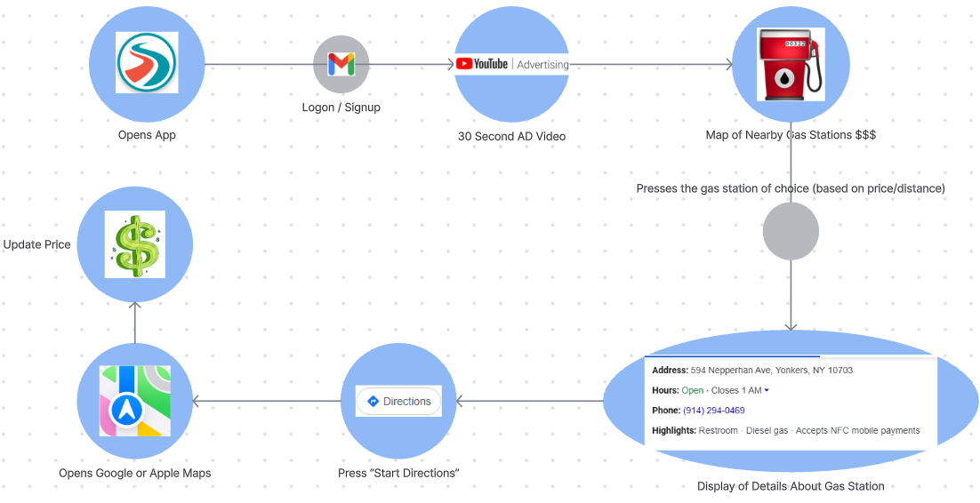
User Journey Map

Slide 6


Business Model
Advertising Revenue
Partner with gas stations and automotive services (car washes, mechanics, convenience stores) for sponsored listings or promoted stations in the app.
Affiliate Partnership
Earn commissions through referrals to gas station reward programs, tire retailers, or car maintenance services (like AutoZone).
Premium Subscriptions
Offer advanced features like ad-free browsing, price alerts, trip planning with optimal stops, or early access to crowdsourced data for a small monthly fee.

Slide 7
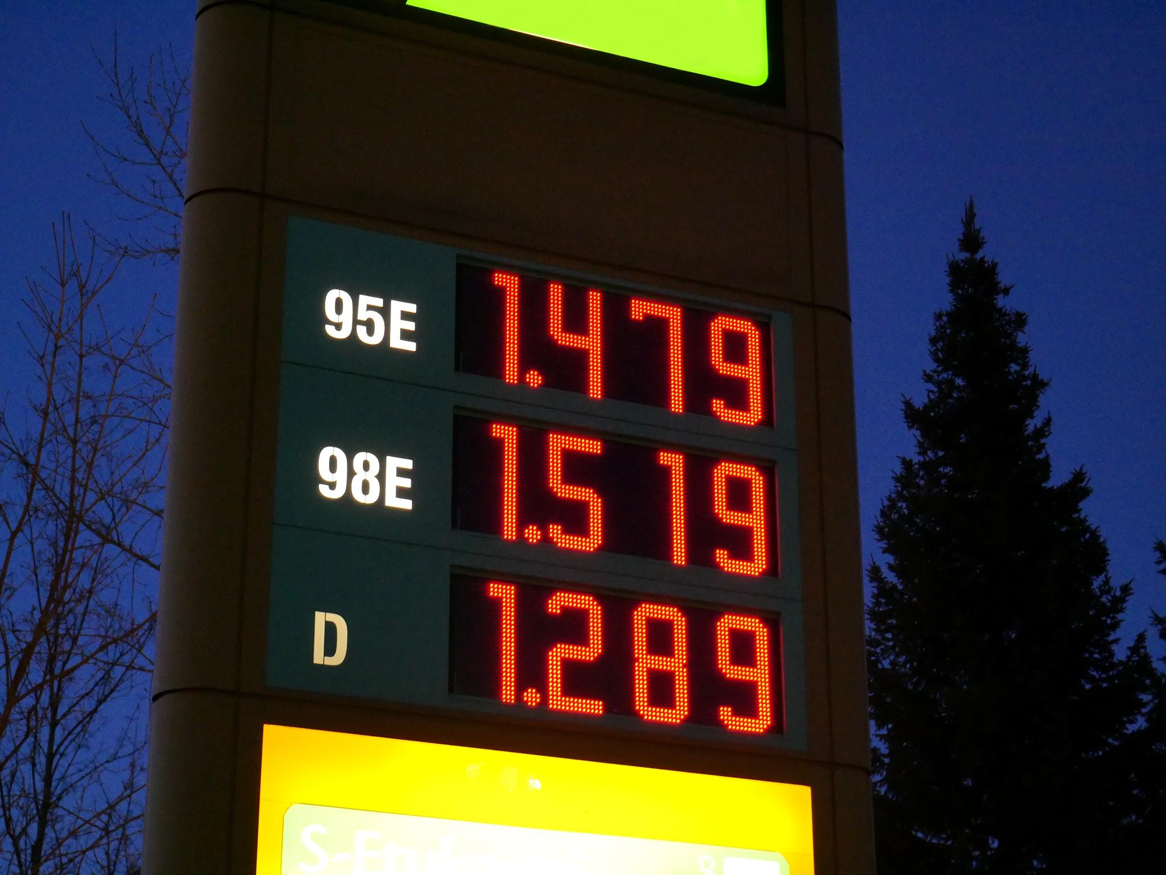
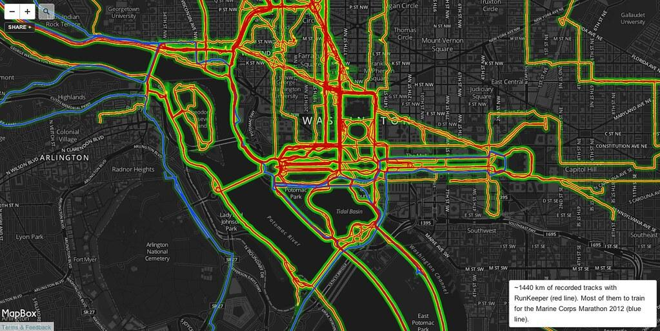
Business Model : Data for sale
Business Opportunity:
Sell anonymized fuel pricing trends
Provide data on fuel price changes without revealing personal info, helping businesses predict price shifts.
Offer user traffic data
Share info on traffic patterns to improve infrastructure and transportation planning.
Provide geo-behavioral analytics
Offer insights into user locations and driving behaviors to help businesses understand customer needs.

Slide 8
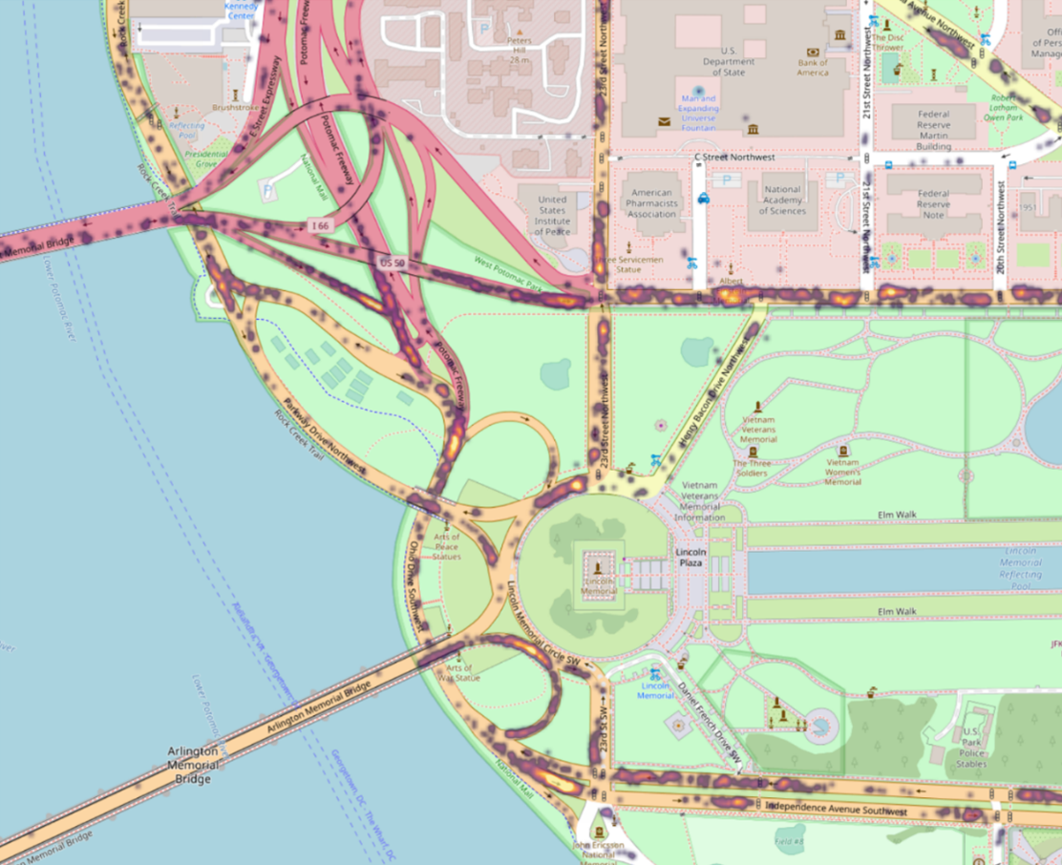
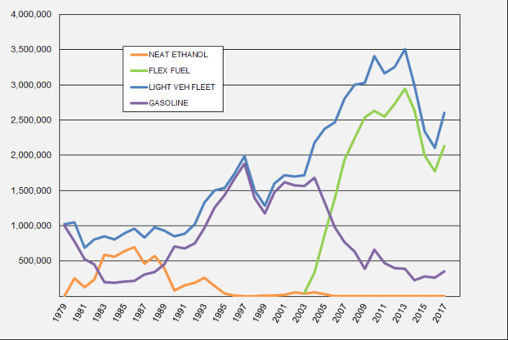
Business Model : Data for sale
Business Opportunity :
Target transportation companies:
Help optimize routes and reduce costs with fuel price and traffic data.
Engage local governments:
Support city planning and public transport with traffic and fuel pricing insights.
Cater to market researchers:
Provide data to help researchers study consumer behavior and transportation trends.

Slide 9
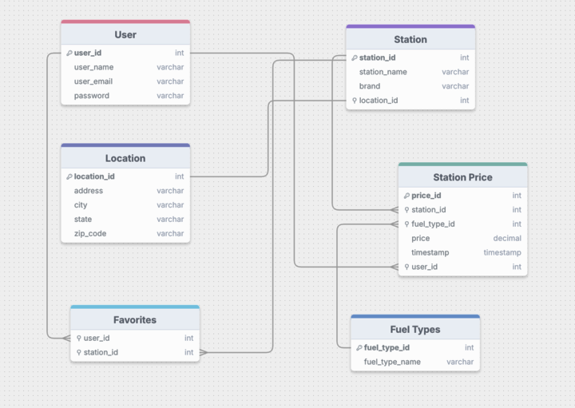
Data Design Diagram

Slide 10



Tech Stack - Front End
HTML, CSS, Vanilla JavaScript
Simple, lightweight, and easy to maintain without needing additional frameworks.
Fetch API for asynchronous requests
Simplifies making asynchronous requests, improving user experience by loading data dynamically without refreshing the page.
Geolocation API for location-based features
Allows location-based features like maps or nearby searches to enhance user interaction.

Slide 11

Tech Stack - Back End
Node.js for server-side JavaScript
Fast, scalable, and efficient for handling I/O-bound operations and high concurrency, making it ideal for real-time applications.
Express.js framework for building RESTful APIs
Lightweight, flexible framework that speeds up API development with minimal setup and powerful routing capabilities.
JWT for authentication
Provides a secure, stateless authentication system, ensuring data integrity and protecting against unauthorized access.

Slide 12




Tech Stack - Other
Database: MySQL
MySQL offers scalability for larger projects, both providing reliable data storage.
APIs: Google Places API for location-based data
Enhances user experience with accurate location-based data, such as nearby places, addresses, or points of interest.
Deployment:
Heroku + docker (backend): simplifies backend deployment.
Vercel (frontend): frontend deployment quick and efficient with continuous integration and auto-scaling

Slide 13

Member Roles
Back-End
UI / UX Designer
Front-End
QA / Testing Lead
Database Management
Project Management
Roles:
UI / UX Designer / Front-end : Mustafa Donmez
Back-End / Front-End: Muhammad Ahmed
Front-End / Project Management: Rafid Rahman
Database Management / Project Management: Nizar Azar
Back-End / QA / Testing Lead: Shahed Ahmed
Backend / Database Management: Kalelo Dukuray

Slide 14
Questions?

